Slide 1
Day 1

Slide 2
Agenda
Basics
Constraint Layout
Linear Layout
Activity Basics
TextView
EditText
Buttons
24/05/2021
Basic Java
2

Slide 3
Basic

Slide 4
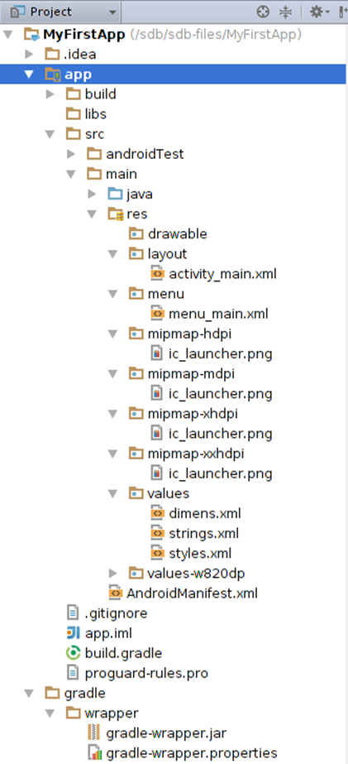
Android Project Overview
Build : For storing app APK.
Java : For storing java files.
Drawable: Used to store media files.
Layout: For storing layouts of the app.
Values: Used to store certain values for reusability. For example storing a App Name in string.xml for later use.

Slide 5
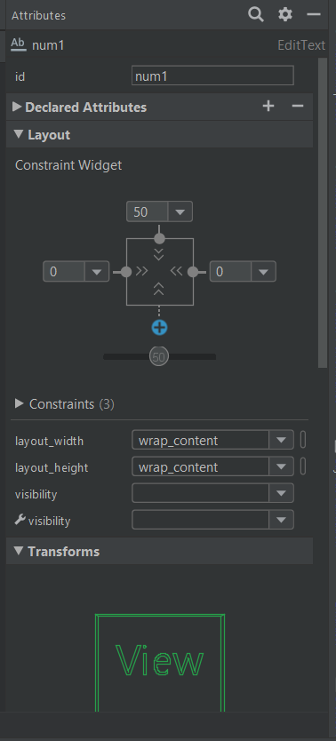
Android Attributes Overview
It provides an interface where we can edit attributes of the widget, layout or any view.
It also provide search to ease the retrieval of the desired attributes.

Slide 6
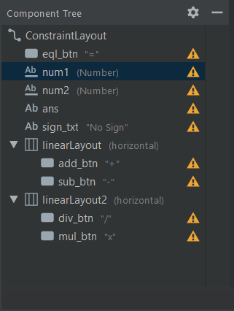
Android Component Tree Overview
It provides the structure of the layout in the form of tree.
Also provides warnings and errors if the layout is not established properly.

Slide 7
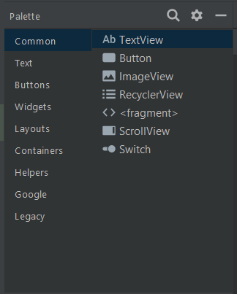
Android Palette Overview
It provides an interface where we can drag and drop the selected widget.
It also provides various types of widgets in a nice segregated manner.

Slide 8
Constraint Layout

Slide 9
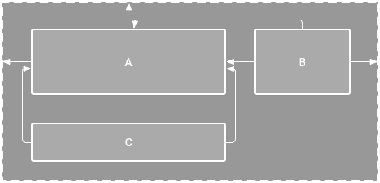

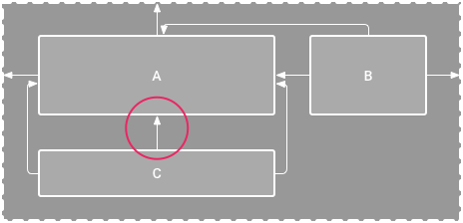

Constraint Layout
A Constraint Layout is a default Android Studio layout which allows you to position and size widgets in a flexible way.
To define a view's position in Constraint Layout, you must add at least one horizontal and one vertical constraint for the view.
Two types of default size:
Wrap Content – It wrap the view size according to minimum required size.
0dp (Match Parent) – It will extend to its parent size.
Figure 1. The editor shows view C below A, but it has no vertical constraint
Figure 2. View C is now vertically constrained below view A

Slide 10
Linear Layout

Slide 11
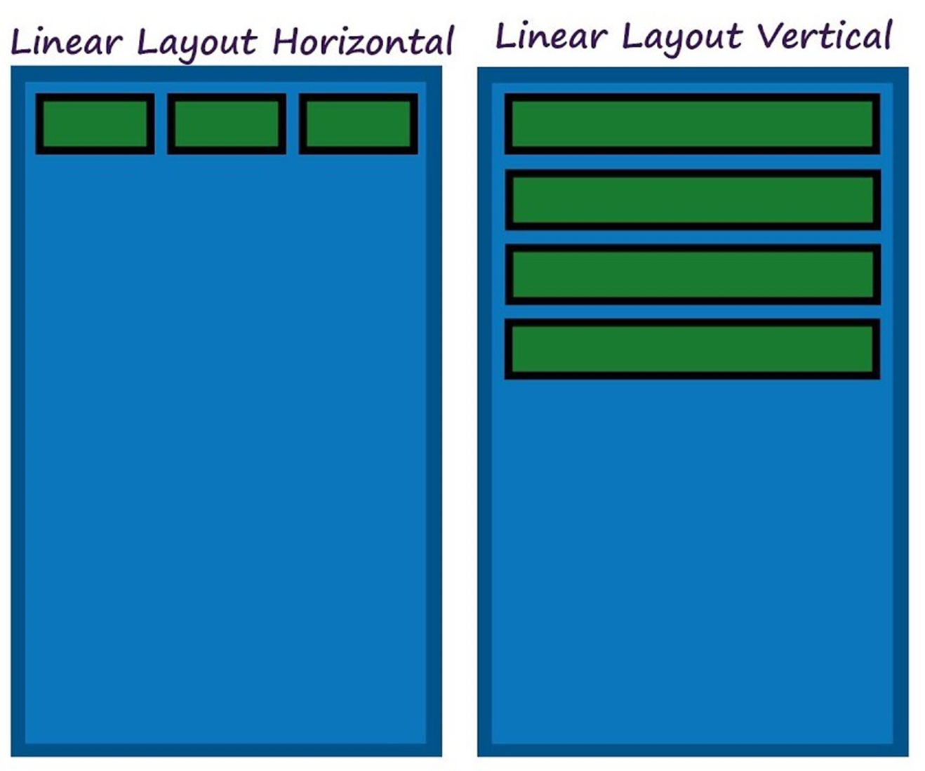
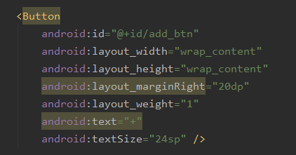
Linear Layout
Linear Layout is a view group that aligns all children in a single direction, vertically or horizontally.
To define a view's position in Constraint Layout, you must specify the orientation(horizontal or vertical).
Also you can provide weight to each widget in Linear Layout.

Slide 12
Activity Basics

Slide 13
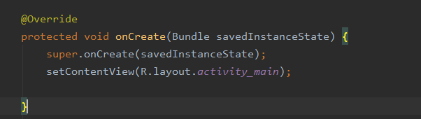
Activity Class File
Activity class takes care of creating a window for you in which you can place your UI with setContentView(View)
OnCreate is called when the activity is first created. This is where you should do all of your normal static set up

Slide 14
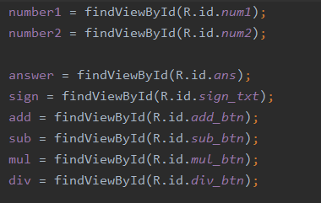
How to assign widget to its ID?
We will use the function getViewById(ID).
Any ID can be extracted from the following format: R.id.id_name.

Slide 15
TextView

Slide 16
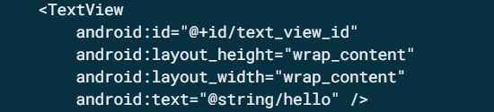
TextView
TextView widget is used to show Text to user.
Main TextView Functions:
getText() : To retrieve Text from the widget.
setText(String s) : To set a string for the widget to display.

Slide 17
EditText

Slide 18
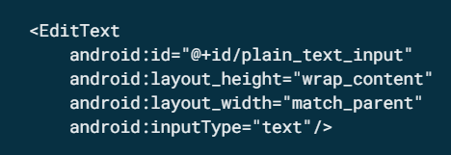
EditText
EditText widget is used for input from user.
Main EditText Functions:
getText() : To retrieve Text from the widget.
setText(String s) : To set a string for the widget to display.

Slide 19
Button

Slide 20
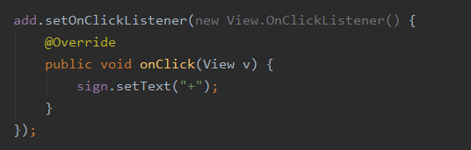
Button
A user interface element the user can tap or click to perform an action.
Main Button Functions:
getText() : To retrieve Text from the widget.
setText(String s) : To set a string for the widget to display.
setOnClickListener: To set a listener for the button.

Slide 21
Thank you

